Slide 1
Supplemental Figure S1: Cultivable bacterial diversity identified based on 16S rRNA gene sequence and its spatial distribution.
Top: The checkboard graph represents distribution of cultivable bacteria from various locations. Number of isolated strains are also depicted. Bottom: The neighbor-joining trees were created using MEGA 7. The evolutionary history was inferred by using the Maximum Likelihood method based on the Tamura-Nei model. Number of the isolated strains are given in parentheses.
Supplemental Figure S2: Cultivable fungal diversity identified based on ITS gene sequence and its spatial distribution.
Top: The checkboard graph represents distribution of cultivable fungi from various locations. Number of isolated strains are also depicted. Bottom: The neighbor-joining trees were created using MEGA 7. The evolutionary history was inferred by using the Maximum Likelihood method based on the Tamura-Nei model. Number of the isolated strains are given in parentheses.
Supplemental Figure S3: Metagenomic sequencing analysis of Analog habitat
(A) Bar plot showing the relative abundances of bacterial genera in samples collected from different sites of Analog habitat. Each site refers to a various sampling location, as per Table 1. Each colored box, a bacterial taxon and the height of a colored box represents the relative abundance of organism (left) within the sample.
(B) Bar plot showing the relative abundances of fungal genera in samples collected from different sites of Analog habitat. Each site refers to a various sampling location, as per Table 1. Each colored box, a bacterial taxon and the height of a colored box represents the relative abundance of organism (left) within the sample.
Supplemental Figure S4: Metagenomic sequencing analysis of bacteria of the Analog habitat
Heat map showing the relative abundance of each functional gene detected in each sample collected.

Slide 2
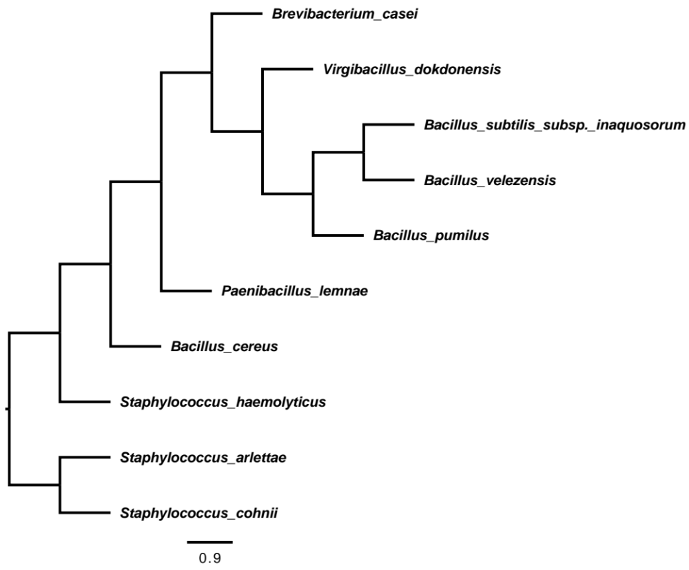
Supplemental Figure S1
Bacterial Culture Classification | Analog habitat sampling locations |  |  |  |  |  |  |  | Abundance
 | E3 | E4 | E5 | E6 | E7 | E12 | E13 | E16
Bacillus pumilus |  | 1 | 4 | 2 | 3 | 4 | 1 | 1 | 16
Bacillus velezensis |  |  |  |  |  |  | 1 |  | 1
Bacillus subtilis |  |  |  |  |  | 2 |  |  | 2
Bacillus cereus |  | 1 |  |  | 1 |  |  | 3 | 5
Virgibacillus chiguensis |  |  |  |  |  |  |  | 1 | 1
Brevibacterium caesai |  |  |  |  |  |  | 1 |  | 1
Paenibacillus lemnae |  |  |  |  |  | 1 |  |  | 1
Staphylococcus haemolyticus | 3 |  |  |  |  |  |  |  | 3
Staphylococcus cohnii |  |  | 1 |  |  |  |  |  | 1
Staphylococcus arlettae |  |  |  |  | 2 |  |  |  | 2
Total No. Isolates/Location | 3 | 2 | 5 | 2 | 6 | 7 | 3 | 5 | 33
(1)
(1)
(2)
(1)
(16)
(1)
(5)
(3)
(2)
(1)

Slide 3
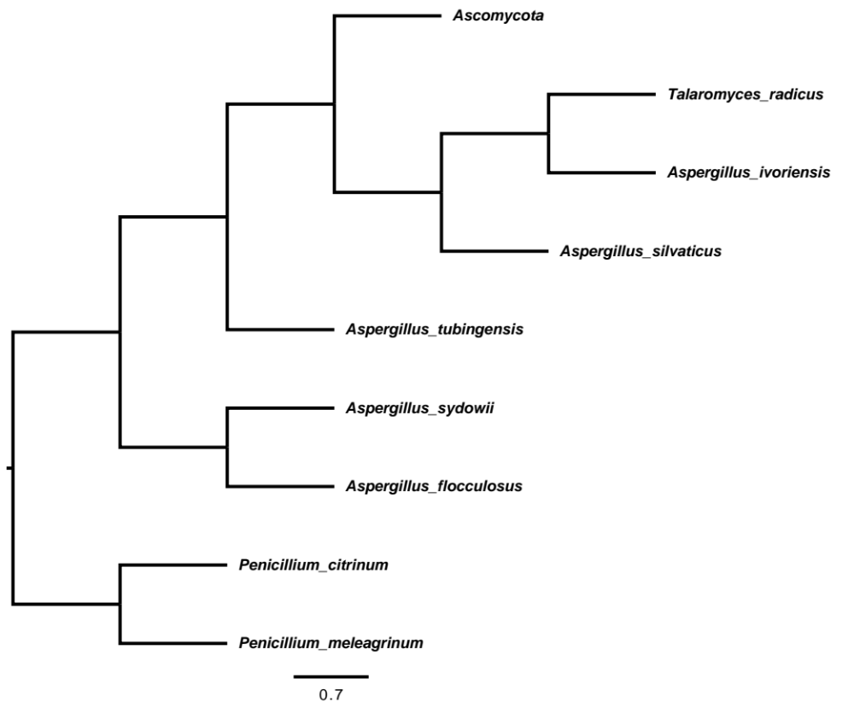
Supplemental Figure S2
Fungal Culture Classification | Analog habitat sampling locations |  |  |  |  |  |  |  |  |  |  | Abundance
 | E3 | E4 | E5 | E6 | E7 | E8 | E11 | E12 | E13 | E15 | E16
Aspergillus sydowii | 3 | 2 | 1 | 2 | 4 |  | 1 | 2 | 1 | 1 |  | 17
Aspergillus silvaticus |  |  |  |  | 1 |  |  | 2 |  |  | 1 | 4
Penicillium citrinum |  | 2 |  |  |  |  |  |  |  |  |  | 2
Aspergillus tubingensis |  |  | 3 |  |  |  |  |  | 3 |  | 1 | 7
Ascomycota sp. |  | 1 | 3 |  |  | 1 | 1 |  | 2 |  |  | 8
Aspergillus flocculosus |  |  |  |  | 2 |  |  |  |  |  | 4 | 6
Penicillium meleagrinum |  |  |  |  |  |  |  | 1 |  |  |  | 1
Aspergillus ivoriensis |  |  |  |  |  | 1 |  |  |  |  |  | 1
Talaromyces radicus |  |  |  |  |  | 1 |  |  |  |  |  | 1
Total No. Isolates/Location | 3 | 5 | 6 | 2 | 7 | 3 | 2 | 5 | 6 | 1 | 6 | 47
(8)
(1)
(1)
(4)
(7)
(17)
(6)
(2)
(1)
Notes:
Figure 4A: The black fields in the checkboard graph show at which sampling event, at least one isolate of each species was isolated.
Preparing fungal tree

Slide 4
A
Supplemental Figure S3
B

Slide 5
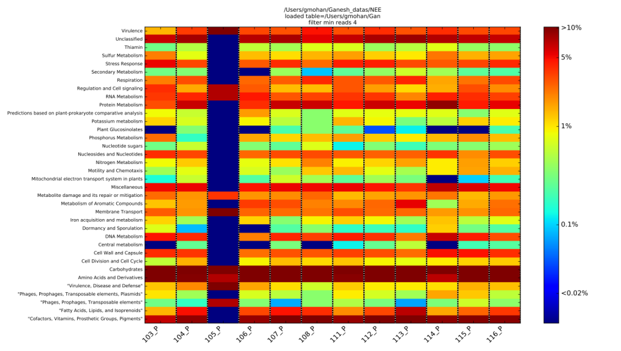
Supplemental Figure S4
E3P
E4P
E5P
E6P
E7P
E8P
E11P
E12P
E13P
E14P
E15P
E16P

